Slide 1
Rplot
2023.03.25
簡廷因

Slide 2
Outline
plot function
Basic Statistical Chart & Table
Map

Slide 3
plot function

Slide 4
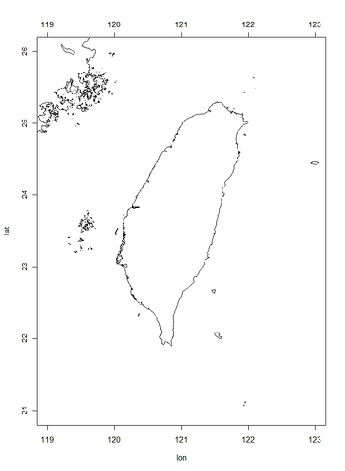
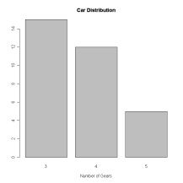
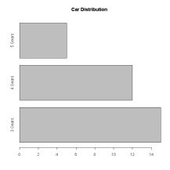
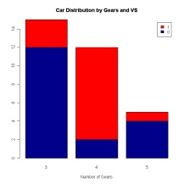
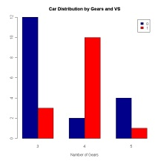
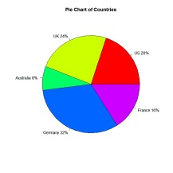
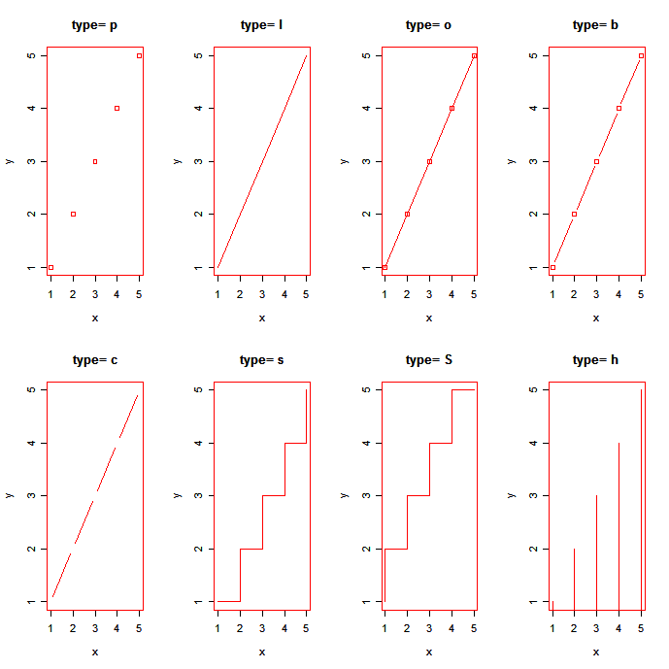
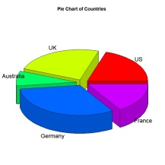
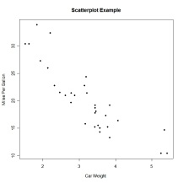
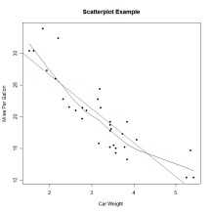
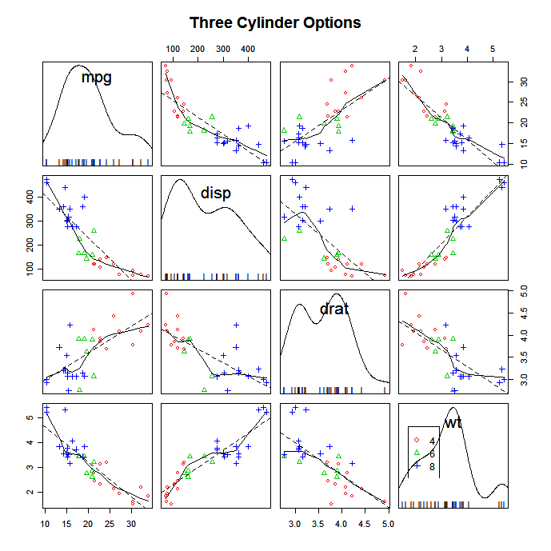
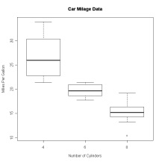
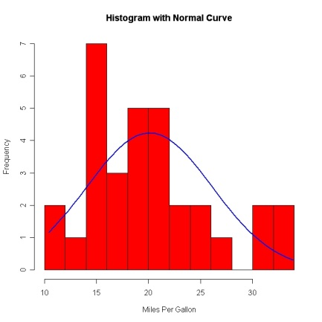
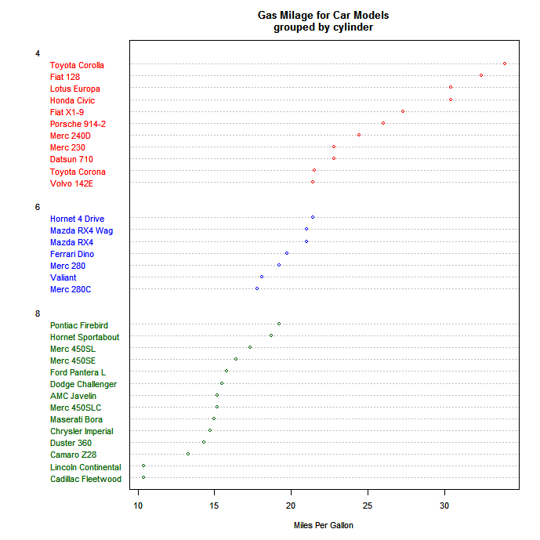
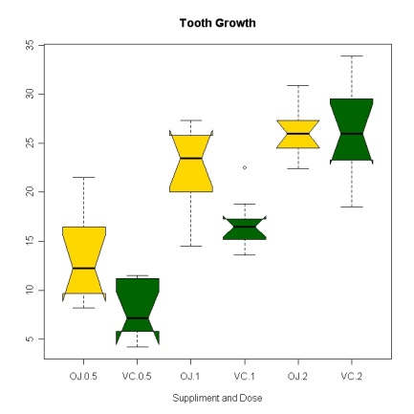
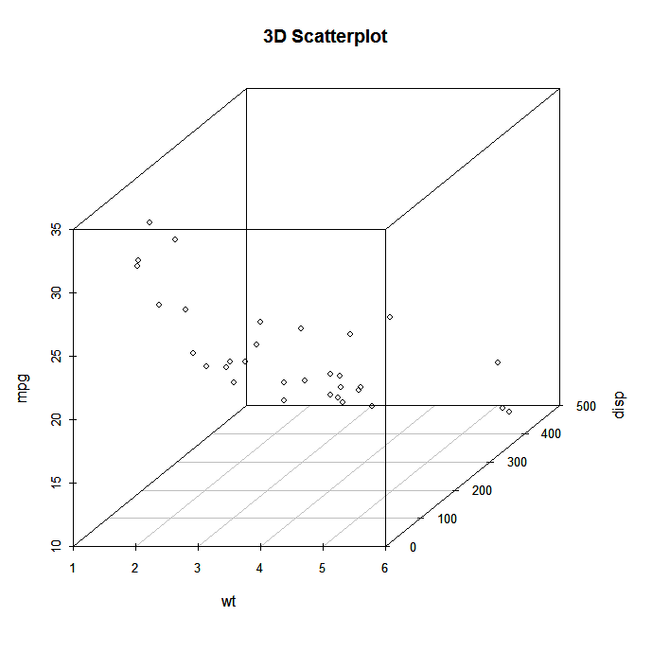
Plot controlling in R (http://www.statmethods.net/index.html)
You can plot most of things by R and save your time for high-throughput data analysis
Moreover, you can plot something special…
http://personlin.pixnet.net/blog/post/23285250

Slide 5
Outline
Plot
High-level
Low-level
Basic plot controlling

Slide 6
High-level vs. low-level plots
High-level
Generate a plot that cannot be replaced except a plot from another high-level plotting function
Low-level
Generate items for decorating a plot from a high-level plotting function

Slide 7
High-level and low-level plots (cont.)
High-level
plot(), matplot(), hist(), boxplot(), heatmap(), …
Low-level
legend(), points(), lines(), ablines(), text(), …
title(), mtext(), …
Other plot functions
help(par)

Slide 8
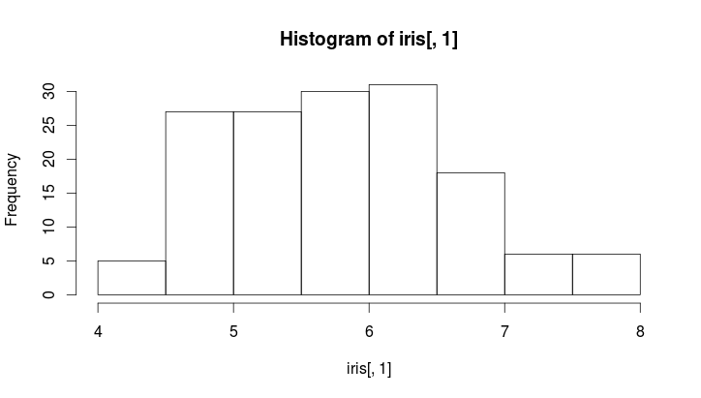
Elements in a figure Example: hist()
Main title: main
Title of y-axis: ylab
Y-axis: ylim
X-axis: xlim
Title of x-axis: xlab

Slide 9
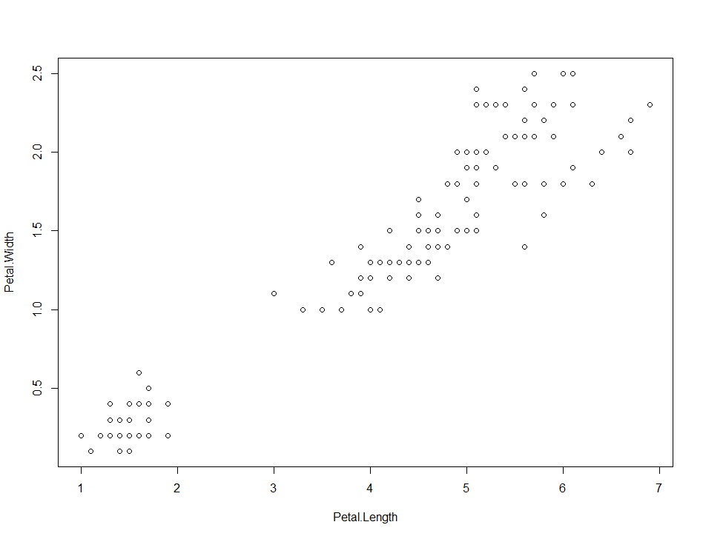
Basic plot controlling
Graphical Parameters
Something special in high-level
matplot(), boxplot()
Something special in low-level
abline(), legend()
Write out files
> plot(iris[,3:4])

Slide 10
Graphical Parameters

Slide 11
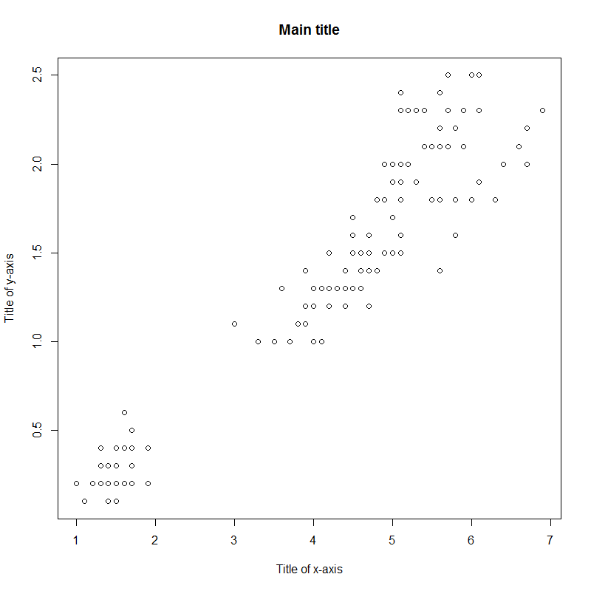
Graphical Parameters
Titles in high-level plot
option | description
main | Main title
xlab | Title of x-axis
ylab | Title of y-axis
> plot(iris[,3:4],main="Main title", xlab="Title of x-axis", ylab="Title of y-axis")

Slide 12
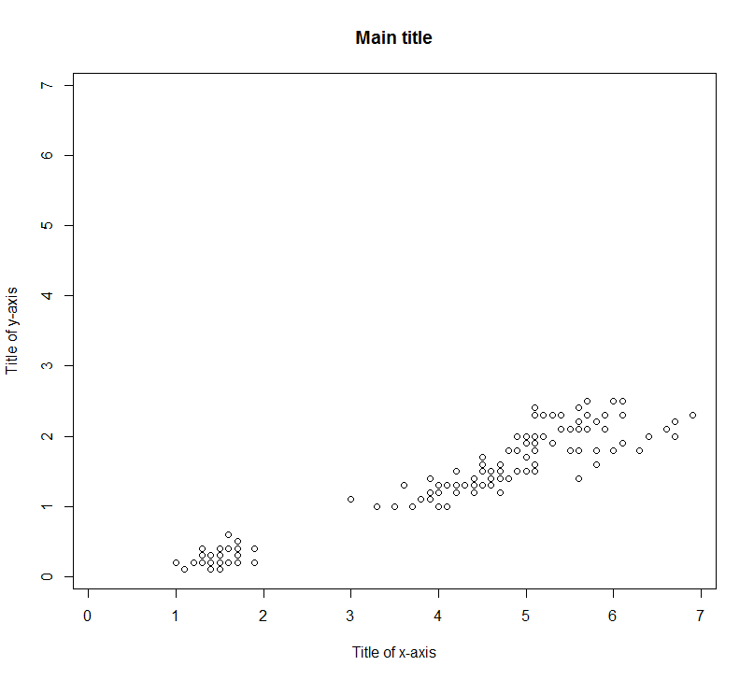
Graphical Parameters (cont.)
Range of x-/y-asix
option | description
xlab | Title of x-axis
ylab | Title of y-axis
xlim | the range of x
ylim | the range of y
> plot(iris[,3:4],main="Main title", xlab="Title of x-axis",
+ ylab="Title of y-axis", xlim=c(min(iris[,3:4]),max(iris[,3:4])),
+ ylim=c(min(iris[,3:4]),max(iris[,3:4])))

Slide 13
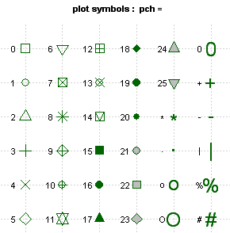
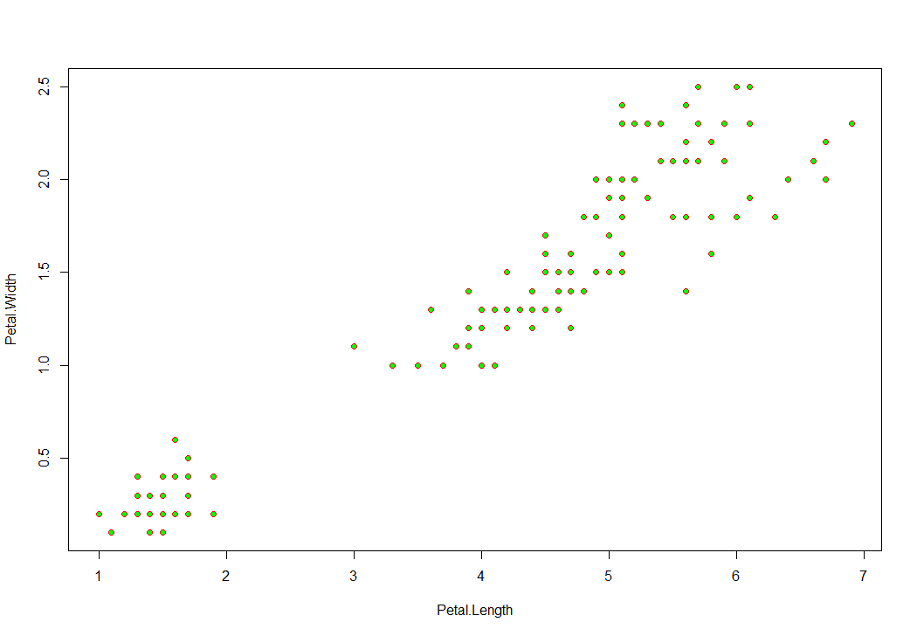
Graphical Parameters (cont.)
Plotting Symbols
Use the pch= option to specify symbols to use when plotting points. For symbols 21 through 25, specify border color (col=) and fill color (bg=).
> plot(iris[,3:4],pch=21, col="red",bg="green")

Slide 14
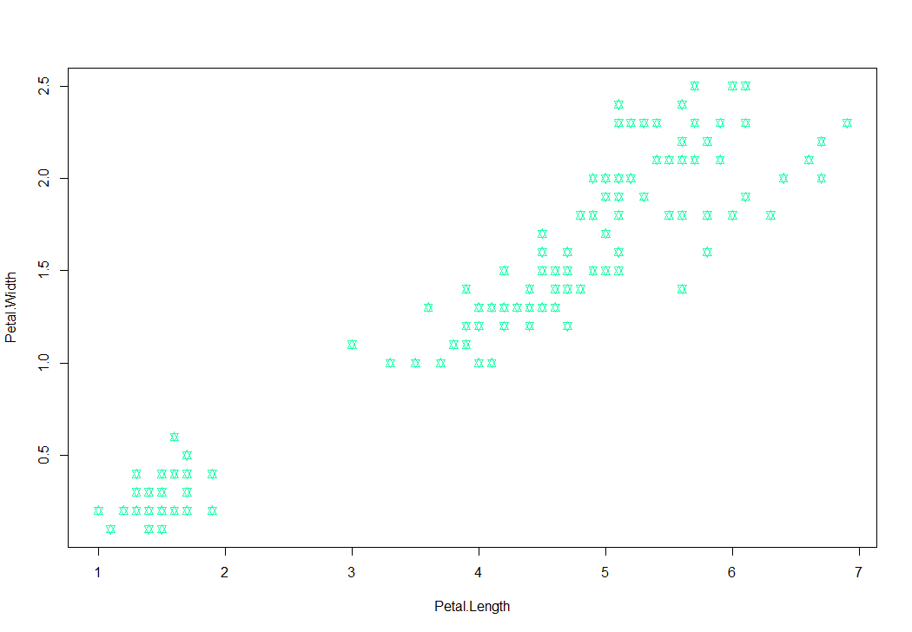
Graphical Parameters (cont.)
Colors
Functions for colors
colors()[n], rainbow(n), heat.colors(n)
Use RGB number
option | description
col | Default plotting color (8 colors). Some functions (e.g. lines) accept a vector of values that are recycled.
col.axis | color for axis annotation
col.lab | color for x and y labels
col.main | color for titles
col.sub | color for subtitles
fg | plot foreground color (axes, boxes - also sets col= to same)
bg | plot background color
> plot(iris[,3:4],pch=11,col="#22FFAA")

Slide 15
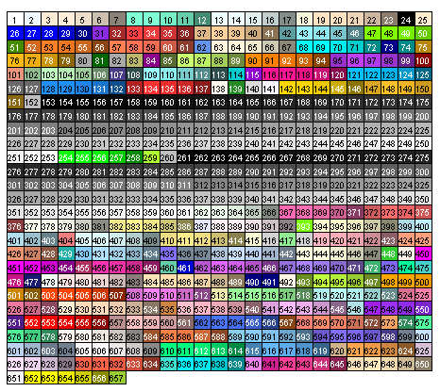
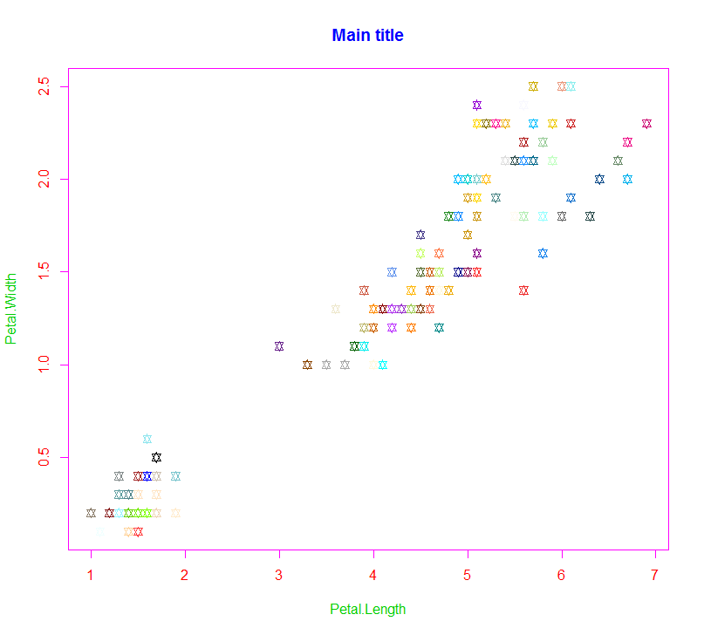
Graphical Parameters (cont.)
colors()[n]
http://research.stowers-institute.org/efg/R/Color/Chart/index.htm
> plot(iris[,3:4],main="Main title",pch=11,
+ col=colors(),col.axis=2, col.lab=3, col.main=4, col.sub=5,fg=6)

Slide 16
Graphical Parameters (cont.)
Text and Symbol Size
option | description
cex | number indicating the amount by which plotting text and symbols should be scaled relative to the default. 1=default, 1.5 is 50% larger, 0.5 is 50% smaller, etc.
cex.axis | magnification of axis annotation relative to cex
cex.lab | magnification of x and y labels relative to cex
cex.main | magnification of titles relative to cex
cex.sub | magnification of subtitles relative to cex
> plot(iris[,3:4],main="Main title",pch=11, cex=2,cex.axis=2, cex.lab=2, cex.main=4, cex.sub=2)

Slide 17
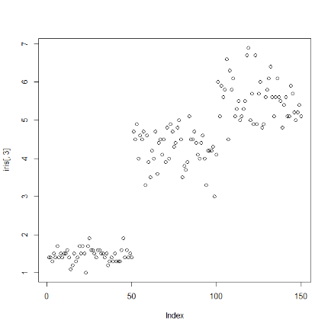
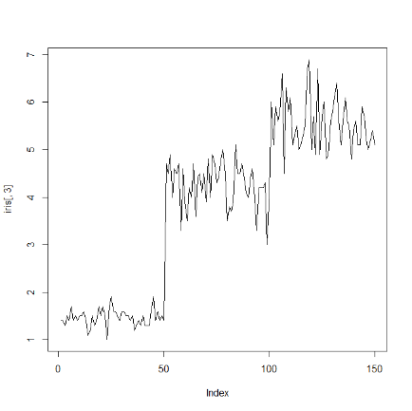
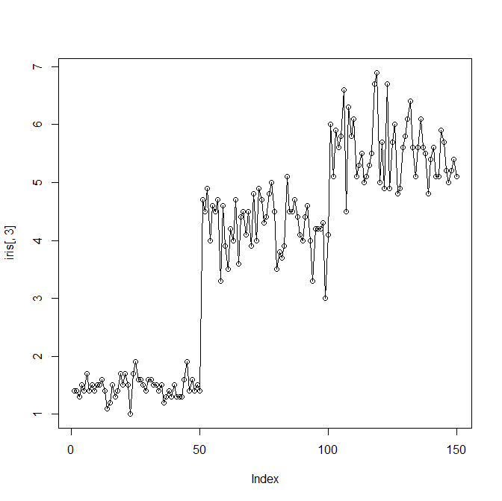
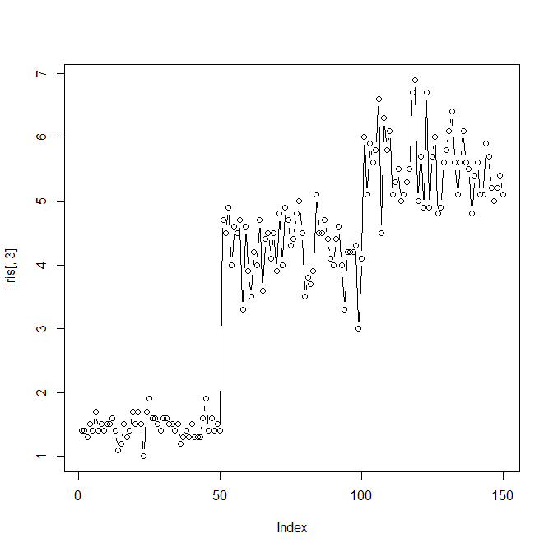
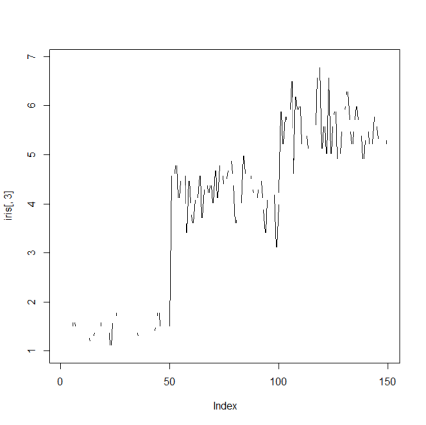

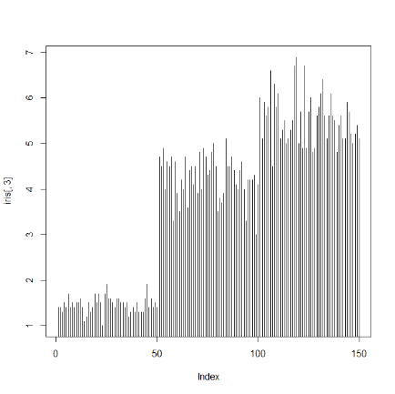
Graphical Parameters (cont.)
Use plot() to construct line charts
p
l
type | description
p | points
l | lines
o | overplotted points and lines
b, c | points (empty if "c") joined by lines
s, S | stair steps
h | histogram-like vertical lines
n | does not produce any points or lines
o
b
h
c
s
> plot(iris[,3],type="p")

Slide 18
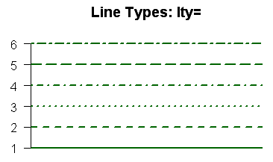


Graphical Parameters (cont.)
Lines
option | description
lty | line type. see the chart below.
lwd | line width relative to the default (default=1). 2 is twice as wide.
> plot(iris[,3],type="l", lty=2, lwd=3)

Slide 19
Other Graphical Parameters (cont.)
Fonts
option | description
font | Integer specifying font to use for text. 1=plain, 2=bold, 3=italic, 4=bold italic, 5=symbol
font.axis | font for axis annotation
font.lab | font for x and y labels
font.main | font for titles
font.sub | font for subtitles
ps | font point size (roughly 1/72 inch) text size=ps*cex
family | font family for drawing text. Standard values are "serif", "sans", "mono", "symbol". Mapping is device dependent.

Slide 20
Something special in low-level plot

Slide 21
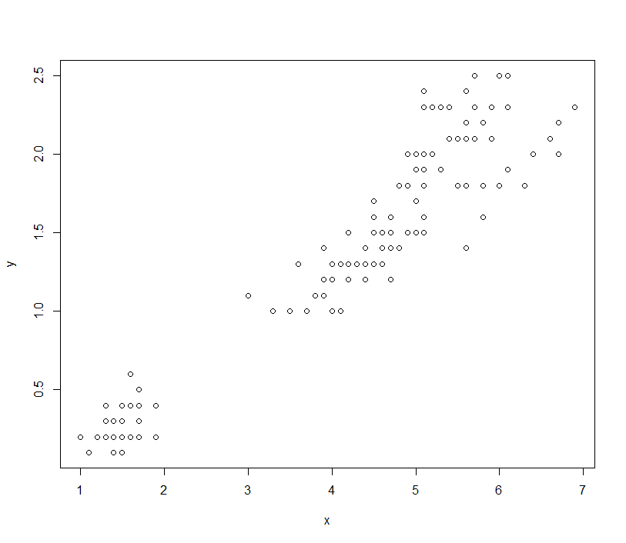
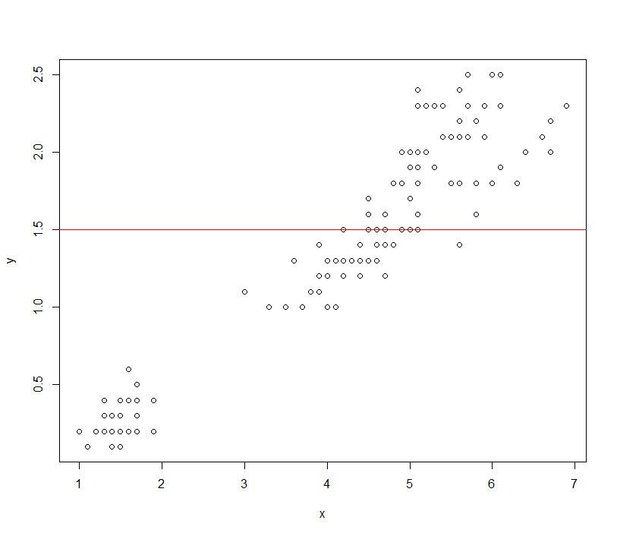
Adding lines in a figure
abline(a = NULL, b = NULL, h = NULL, v = NULL)
a, b | the intercept and slope, single values.
h | the y-value(s) for horizontal line(s).
v | the x-value(s) for vertical line(s).
> x=iris[,3]
> y=iris[,4]
> plot(x,y)
> abline(h=1.5,col=2))

Slide 22
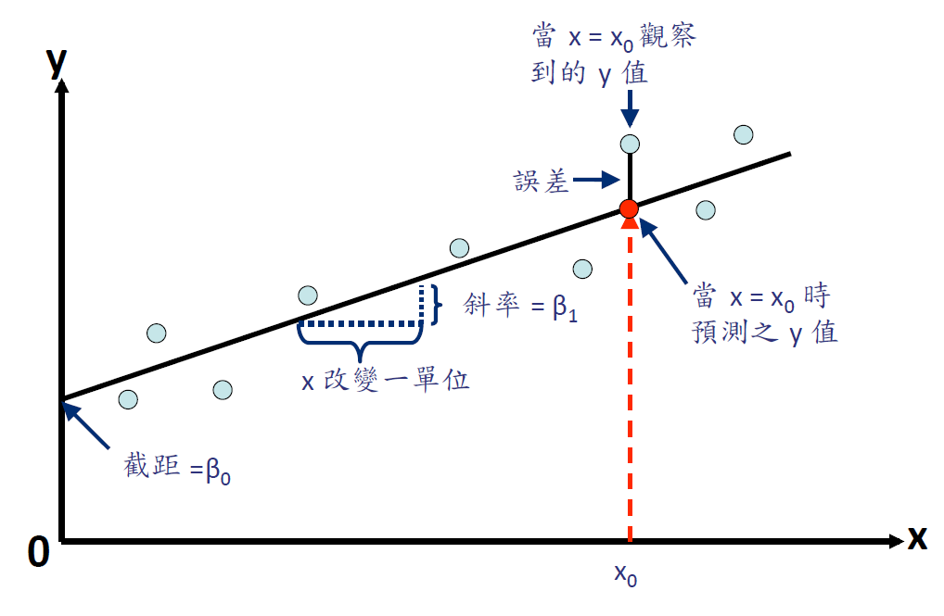
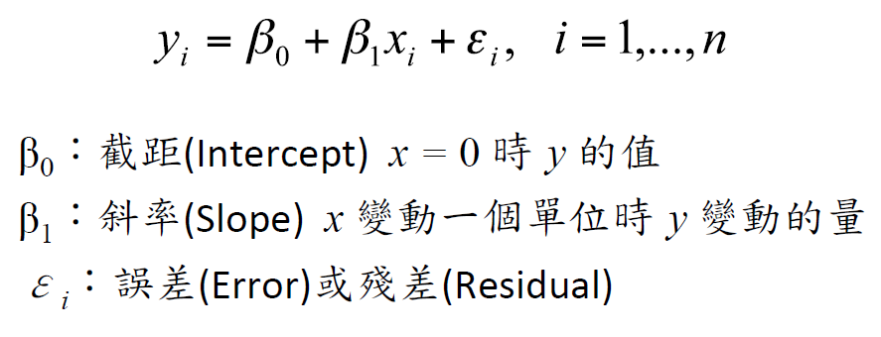
Functions for linear regression
How to find the best fitted line?
Least squares

Slide 23
Functions for linear regression
> x=iris[,3]
> y=iris[,4]
> out=lm(y~x) # lm :linear model
> out
Call:
lm(formula = y ~ x)
Coefficients:
(Intercept) x
-0.3631 0.4158
> out$coefficients[1]
(Intercept)
-0.3630755
> out$coefficients[2]
x
0.4157554
y = – 0.3631+0.4158 x

Slide 24
Functions for linear regression
> a = summary(out)
> a
Call:
lm(formula = y ~ x)
Residuals:
Min 1Q Median 3Q Max
-0.56515 -0.12358 -0.01898 0.13288 0.64272
Coefficients:
Estimate Std. Error t value Pr(>|t|)
(Intercept) -0.363076 0.039762 -9.131 4.7e-16 ***
x 0.415755 0.009582 43.387 < 2e-16 ***
---
Signif. codes: 0 ‘***’ 0.001 ‘**’ 0.01 ‘*’ 0.05 ‘.’ 0.1 ‘ ’ 1
Residual standard error: 0.2065 on 148 degrees of freedom
Multiple R-squared: 0.9271, Adjusted R-squared: 0.9266
F-statistic: 1882 on 1 and 148 DF, p-value: < 2.2e-16

Slide 25
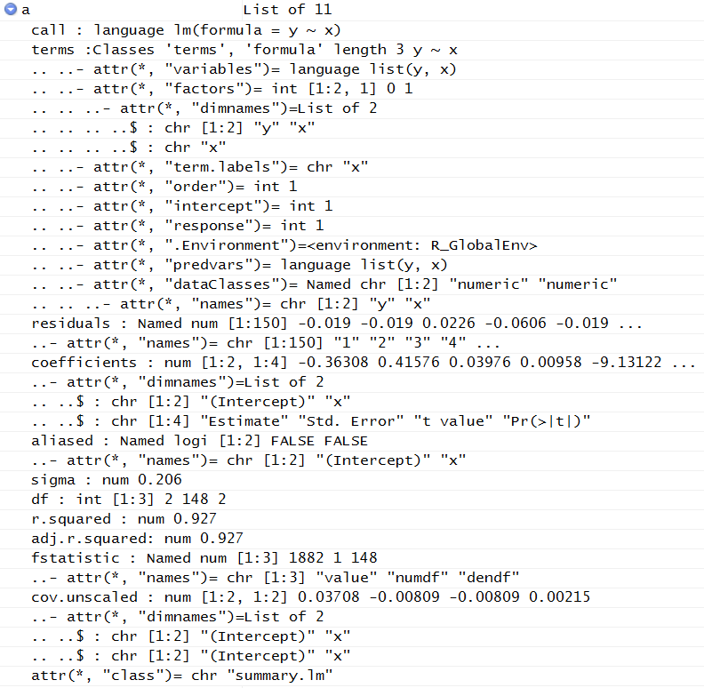
Functions for linear regression
> a$r.squared
[1] 0.9271098

Slide 26
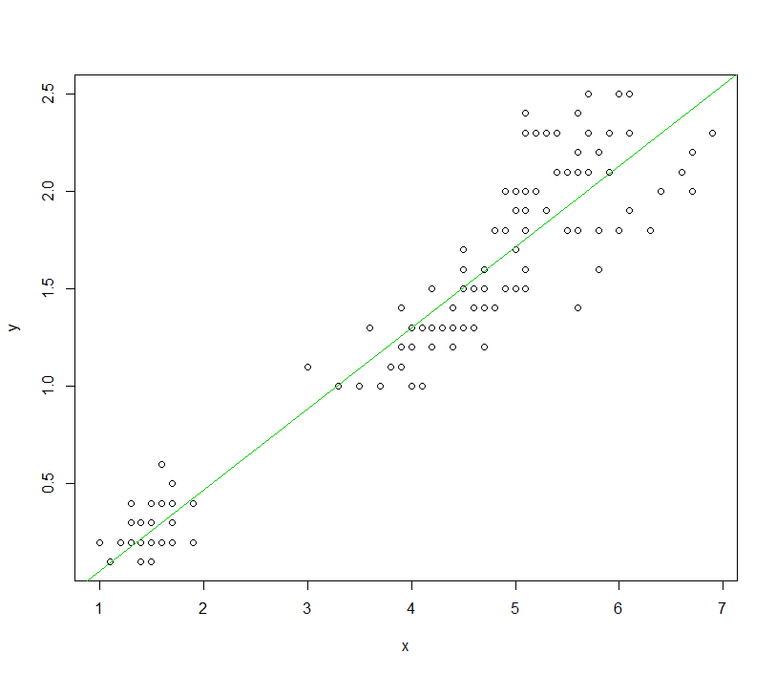
Functions for linear regression
> x=iris[,3]
> y=iris[,4]
> plot(x,y)
> fit=lm(y~x)
> abline(fit,col=3)

Slide 27
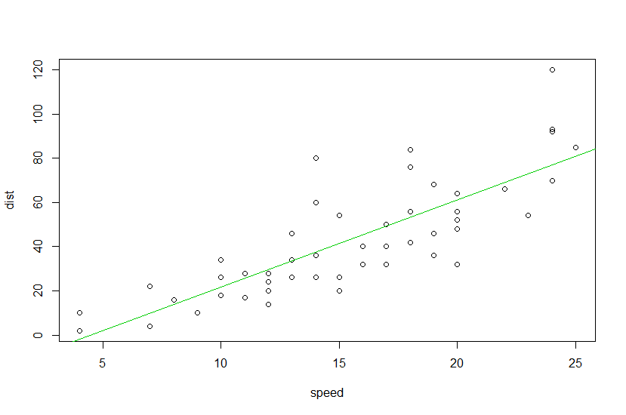
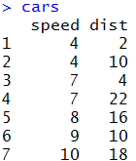
Exercise
Data : Cars
Calculate the fitted line between speed and stopping distance and plot it on the scatter plot
Calculate the correlation coefficient between car’s speed and car’s stopping distance
cor(x,y)

Slide 28
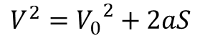
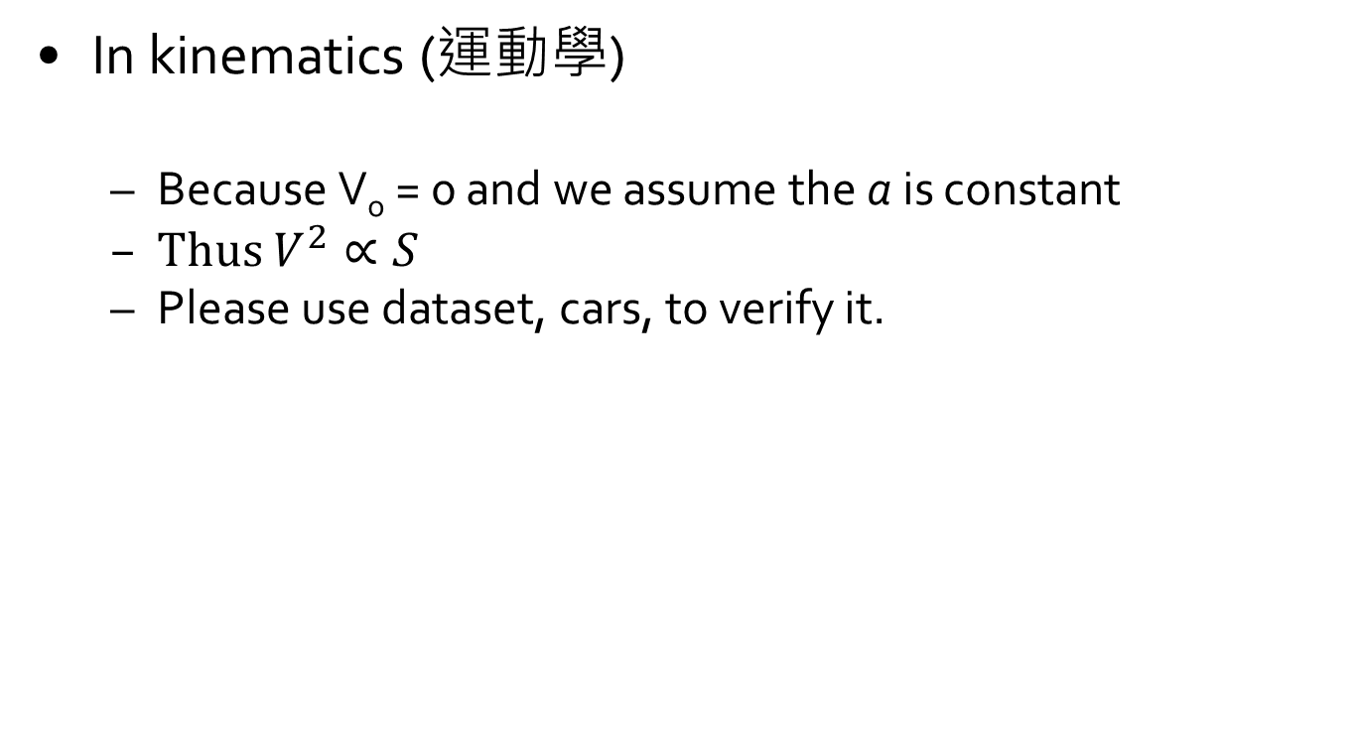
Exercise
In kinematics (運動學)
Because V_{o} = 0 and we assume the a is constant
Thus $V^{2}∝S$
Please use dataset, cars, to verify it.
$$V^{2}={V_{0}}^{2}+2aS$$

Slide 29
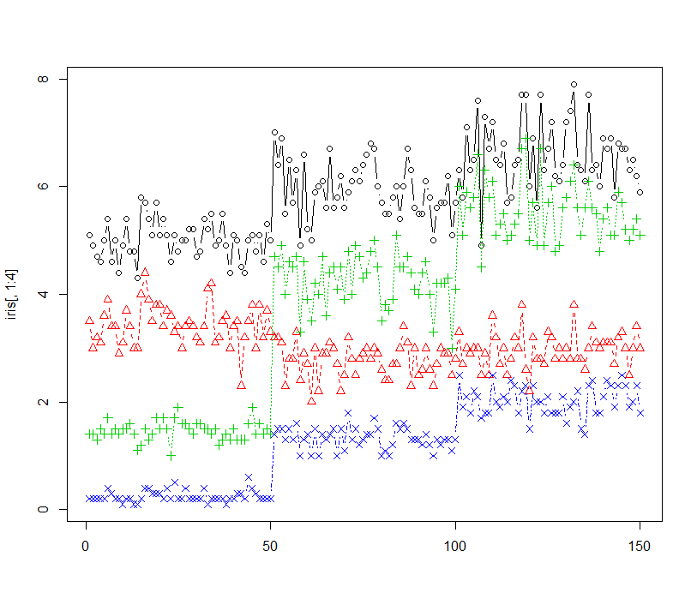
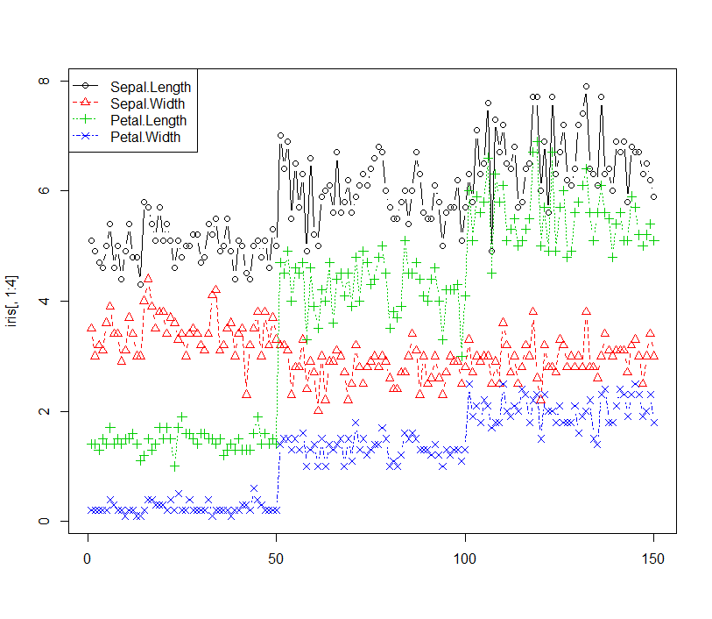
Adding legend in a figure
> matplot(iris[,1:4],type="b",pch=1:4)
legend(position, explanation, pch, lty, col)
position: (x, y) or "bottomleft", "bottomright", "topleft", "topright"
explanation, pch, lty, col: using "c" function
>legend("topleft",dimnames(iris)[[2]][1:4],
+ pch=1:4,lty=1:4,col=1:4)

Slide 30
Write out files
Open a graph device
Close a graph device
dev.off()
Function | Output to
pdf("mygraph.pdf") | pdf file
win.metafile("mygraph.wmf") | windows metafile
png("mygraph.png") | png file
jpeg("mygraph.jpg") | jpeg file
bmp("mygraph.bmp") | bmp file
postscript("mygraph.ps") | postscript file
> png("barplot.png",width = 10,height = 5,res = 300,units="in")
> barplot ...
> dev.off()

Slide 31
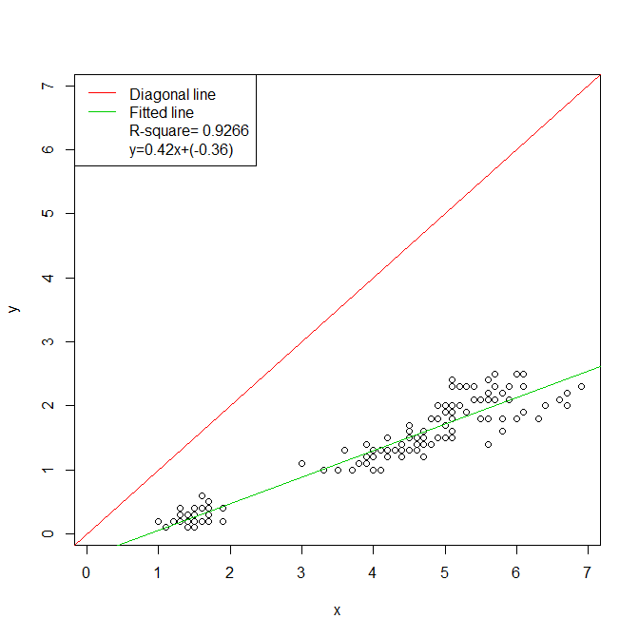
Exercise
Data :iris
Every two columns, except column 5
Save as png
Hint :
xlim = c(min(x,y),max(x,y)), ylim = c(min(x,y),max(x,y))
abline(0,1,col=3) # diagonal line
legend("topleft",c("Diagonal line","Fitted line",paste("R-square =",round(summary(fit)$r.squared,4)),paste("y = ",round(fit$coefficients[2],2)," x + (",round(fit$coefficients[1],2),")",sep="")),lty=c(1,1,0,0),col=c(2,3,"white","white"),bg="white")

Slide 32
Basic Statistical Chart & Table

Slide 33
Basic Statistical Chart & Table
The statistical chart, statistical table and summary statistics are useful analyze complex data
> data(iris)
> iris
Sepal.Length Sepal.Width Petal.Length Petal.Width Species
1 5.1 3.5 1.4 0.2 setosa
2 4.9 3.0 1.4 0.2 setosa
3 4.7 3.2 1.3 0.2 setosa
4 4.6 3.1 1.5 0.2 setosa

Slide 34
Summary statistics
> data(iris)
> x = iris[,1]
> mean(x) #average
[1] 5.843333
> median(x) #median
[1] 5.8
> quantile(x,1) #Max
100%
7.9
> quantile(x,0.2) #the value in 20%
20%
5
> summary(x)
Min. 1st Qu. Median Mean 3rd Qu. Max.
4.300 5.100 5.800 5.843 6.400 7.900

Slide 35
Summary statistics
> data(iris)
> x = iris[,1]
> range(x) # return min and max
[1] 4.3 7.9
> min(x)#min
[1] 4.3
> max(x) #max
[1] 7.9
> var(x)#variance
[1] 0.6856935
> sd(x)#standard deviation
[1] 0.8280661

Slide 36
Summary statistics
Variable type
discrete variable
Toss the coin, Roll the dice
continuous variable
Height, Weight
 | discrete variable | continuous variable
Statistical Chart | Bar plot (長條圖) Pie chart (圓形圖) | Histogram (直方圖) Box plot (盒鬚圖) Scatter plot(散布圖)

Slide 37
Discrete Variable - Frequency distribution table
Sample data: iris[,5]
 | frequency | cumulative frequency | relative frequency(%) | cumulative relative frequency(%)
setosa | 50 | 50 | 33.33 | 33.33
versicolor | 50 | 100 | 33.33 | 66.67
virginica | 50 | 150 | 33.33 | 100
> table(iris[,5]) # frequency
setosa versicolor virginica
50 50 50
> cumsum(table(iris[,5])) # cumulative frequency
setosa versicolor virginica
50 100 150
> table(iris[,5])/length(iris[,5])*100 # relative frequency
setosa versicolor virginica
33.33333 33.33333 33.33333
> cumsum(table(iris[,5])/length(iris[,5])*100)# cumulative relative frequency
setosa versicolor virginica
33.33333 66.66667 100.00000

Slide 38
Scatter plot
> plot(iris[,3:4],main="Main title", xlab="Title of x-axis", ylab="Title of y-axis")

Slide 39
Line plot
> plot(iris[,3],type="l", lty=2, lwd=3)

Slide 40
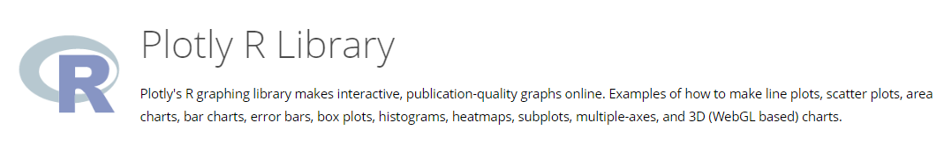
Plotly package
https://plot.ly/r/

Slide 41
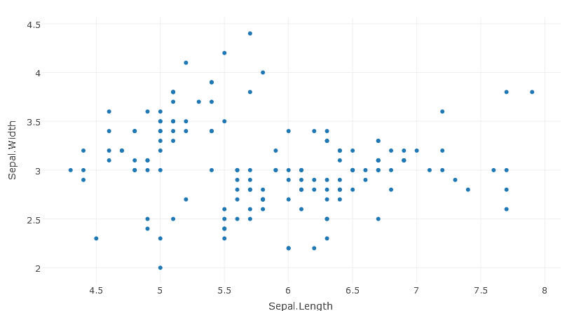
Scatter plot in plotly
https://plot.ly/r/line-and-scatter/
> p = plot_ly(data = iris, x = ~Sepal.Length, y = ~Sepal.Width,type ="scatter",mode = 'markers')
> p

Slide 42
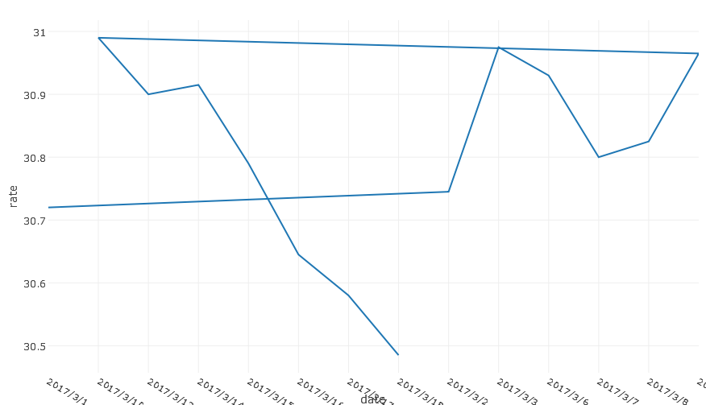
Line plot in plotly
https://plot.ly/r/line-charts/
> data = read.csv("exchangerate.csv",header = T,sep=",")
> p = plot_ly(data, x = ~date, y = ~rate, type = 'scatter', mode = 'lines')
> p
???????????

Slide 43
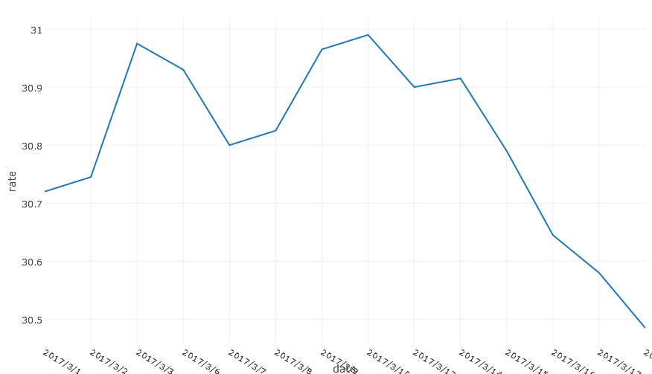
Line plot in plotly
> data = read.csv("exchangerate.csv",header = T,sep=",")
> data[,1] = ordered(data[,1], levels = data[,1])
> p = plot_ly(data, x = ~date, y = ~rate, type = 'scatter', mode = 'lines')
> p

Slide 44
Discrete Variable - Bar plot
> barplot(table(iris[,5]))
> barplot(table(iris[,5]),hori=T)

Slide 45
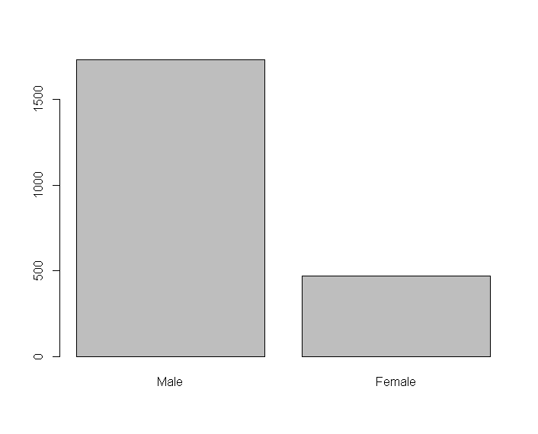
Discrete Variable - Bar plot
> data = titanic %>%
+ group_by(Sex) %>%
+ summarise(Sexsum = sum(Freq, na.rm=TRUE))
Sex Sexsum
1 Male 1731
2 Female 470
> barplot(data$Sexsum, names.arg=data$Sex)

Slide 46

Exercise
Please use barplot to show the common name in English in 2012.
Hint:
data = read.csv("name_english.csv",sep=",", header=F)
colnames(data) = c("sex", "year", "name", "freq")

Slide 47
Discrete Variable – Pie plot
> x=c("Flower A","Flower B","Flower C")
> pie(table(iris[,5]),labels=x)
> pie(table(iris[,5]))

Slide 48
Discrete Variable – Pie plot
> x=round(table(iris[,5])/length(iris[,5])*100,2)
> lbls=paste(names(x),x,"%")
> pie(table(iris[,5]),labels=lbls)

Slide 49





Exercise
Use function(sample) to simulate the unfair dice
x = sample(1:6, 150, replace=T, prob=c(0.1, 0.1, 0.2, 0.2, 0.2, 0.2))
Please create the frequency distribution table(save as out.csv), bar plot and pie plot.

Slide 50
Exercise
Data
x=read.csv("Taiwan.csv",sep=",")
Plot a bar plot and a pie plot and save as png
By Resident
By Area
> png("barplot.png",width = 10,height = 5,res = 300,units="in")
> barplot ...
> dev.off()

Slide 51


Exercise

Slide 52


Exercise

Slide 53


Bar chart in plotly
https://plot.ly/r/bar-charts/
> library(plotly)
> a = as.data.frame(table(iris[,5]))
> p = plot_ly( data = a,
+ x = ~Var1,
+ y = ~Freq,
+ name = "iris",
+ type = "bar"
+ )
> p

Slide 54

Pie chart in plotly
https://plot.ly/r/pie-charts/
> library(plotly)
> a = as.data.frame(table(iris[,5]))
> p = plot_ly( data = a, labels = ~Var1, values = ~Freq, type = "pie") %>%
+ layout(title = 'iris',
+ xaxis = list(showgrid = FALSE, zeroline = FALSE, showticklabels = FALSE),
+ yaxis = list(showgrid = FALSE, zeroline = FALSE, showticklabels = FALSE))
> p

Slide 55
Exercise
Data
x=read.csv("Taiwan.csv",sep=",")
Use plotly package to plot a bar plot and a pie plot
By Resident
By Area

Slide 56


Exercise

Slide 57


Exercise

Slide 58

Continuous variable - histogram
> x=iris[,2]
> hist(x)

Slide 59

Histogram in plotly
https://plot.ly/r/histograms/
> p = plot_ly(x = iris[,2], type = "histogram")
> p

Slide 60

Continuous variable - box plot
R
R
R
R

Slide 61


Continuous variable - box plot
> x=iris[,2]
> boxplot(x)
> plot(x)

Slide 62
Continuous variable - box plot
$stats
[,1]
[1,] 2.2
[2,] 2.8
[3,] 3.0
[4,] 3.3
[5,] 4.0
$n
[1] 150
$conf
[,1]
[1,] 2.935497
[2,] 3.064503
$out
[1] 4.4 4.1 4.2 2.0
$group
[1] 1 1 1 1
$names
[1] "1"
> x=iris[,2]
> boxplot(x,plot=F) #show result
the lower and upper extremes of the notch
= median ± 1.58*IQR / sqrt(n)

Slide 63


Box Plot Application
Data Preprocessing
Filter outlier
> remove_outliers <- function(x) {
+ qnt = quantile(x, probs=c(.25, .75))
+ H = 1.5 * IQR(x)
+ y = x
+ y[x < (qnt[1] - H)] = NA
+ y[x > (qnt[2] + H)] = NA
+ y
}
> x=iris[,2]
> y = remove_outliers(x)
> boxplot(x)
> boxplot(y)

Slide 64

Boxplot in plotly
https://plot.ly/r/box-plots/
> p = plot_ly(data = iris, y = ~Sepal.Length, type = "box",
+ name="Sepal.Length") %>%
+ add_trace(y = ~Sepal.Width, name="Sepal.Width") %>%
+ add_trace(y = ~Petal.Length, name="Petal.Length") %>%
+ add_trace(y = ~Petal.Width, name="Petal.Width")
> p

Slide 65


Exercise
Data
x=read.csv("Taipei_LAND_A.csv",sep=",",header=T)
Please use boxplot to visualize the data.
boxplot()
plotly()

Slide 66

Multiple data in one figure
matplot()
y₁, y₂, y₃,…
The same x for multiple y
> matplot(iris[,1:4],type="b")
type | description
p | points
l | lines
o | overplotted points and lines
b, c | points (empty if "c") joined by lines
s, S | stair steps
h | histogram-like vertical lines
n | does not produce any points or lines

Slide 67


Multiple boxplot
boxplot()
y₁, y₂, y₃,…
x₁, x₂, x₃,…
> dim(iris)
> dim(cars)
> boxplot(cbind(cars[,1:2],iris[,1:4]))
> boxplot(iris[,1:4])

Slide 68

Multiple scatter plot (matrix plot)
> pairs(iris[,1:4])

Slide 69
Map

Slide 70
Web Resource
https://rstudio.github.io/leaflet/
http://leafletjs.com/reference.html

Slide 71

Map
Create a map (openstreetmap)
> install.packages("leaflet")
> library(leaflet)
> m = leaflet()
> m = setView(m,lng = 121.51, lat = 25.05, zoom = 12)
> m = addTiles(m) # Add default OpenStreetMap map tiles
> m

Slide 72

Map
Add Marker
> library(leaflet)
> m = leaflet()
> m = addTiles(m) # Add default OpenStreetMap map tiles
> m = addMarkers(m, lng=121.51, lat=25.05, popup="Taipei Station")
> m

Slide 73

Map
Add Popup
> library(leaflet)
> m = leaflet()
> m = addTiles(m)
> m = addPopups(m, lng=121.51, lat=25.05, popup="Taipei Station")
> m

Slide 74

Map
Change icon
> library(leaflet)
> UserIcon <- makeIcon(
+ iconUrl = "TRA01.png",
+ iconWidth = 30, iconHeight = 30
+ )
> m = leaflet()
> m = addTiles(m)
> m = addMarkers(m, lng=121.51, lat=25.05,
+ popup="Taipei Station",icon=UserIcon)
> m

Slide 75

Map
> library(leaflet)
> library(dplyr)
> library(httr)
> set_config(config(ssl_verifypeer = 0L))
# AQ Data
> url = "https://data.moenv.gov.tw/api/v2/aqx_p_432?offset=0&limit=1000&&api_key=5b216f64-6725-4be5-a354-bbb5a223ab78&format=csv"
> AQX =read.csv(url,header=T,sep=",")
> aq = AQX %>% select(SiteName,PM2.5,Longitude,Latitude)
> aq$PM2.5 = as.numeric(aq$PM2.5)
> aq$Longitude = as.numeric(aq$Longitude)
> aq$Latitude = as.numeric(aq$Latitude)
# Set Icon
> UserIcon <- icons(
iconUrl = ifelse(aq$PM2.5 < 30,
"good.png",
"bad.png"
),
iconWidth = 30, iconHeight = 30
)
> m = leaflet(data = aq ) %>%
+ addTiles() %>%
+ addMarkers(~Longitude, ~Latitude, icon =
+ UserIcon,popup=paste(aq$SiteName,aq$PM2.5,sep=":"))
> m
Map + Open Data

Slide 76

Exercise
Please show the MRT stations on the map
Data : MRT.csv
Logo : MRT.png

Slide 77
Q&A

